Slide 1
Lab static routing
Submission Template

Slide 2
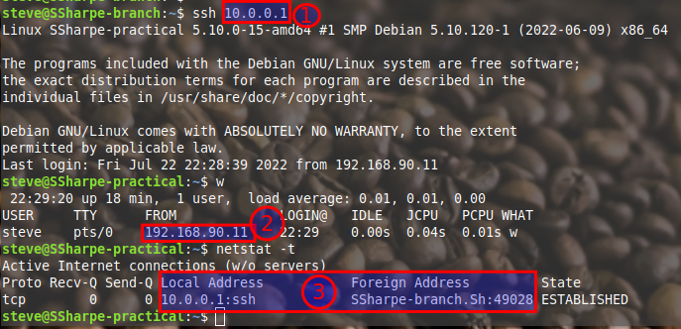
Screen shot 1 with all three points highlighted and clearly visible
DELETE EXAMPLE SCREENSHOT

Slide 3
Screenshot 2 traceroute from one of the partner’s VM to the other partner’s VM
Delete this text
Requirements
Traceroute starting from your tunnel adapter (research how to do a traceroute from a particular interface/ip)
Must end at your partner’s loopback.

Slide 4
Screenshot 3 w (who command)
Delete this
-b bind_address
Use bind_address on the local machine as the source address of the connection. Only useful on systems with more than one address.
Requirement: ssh from one partner to another using the source address of your tunnel adapter to your partner.

